Slide 1
In preparation to the workshop ..
Connect to network:
SSID: WORKSHOP08
Network key: databases
Go to http://192.168.2.1/pack.zip

Slide 2
European Archival Records and Knowledge Preservation
#earkproject www.eark-project.eu @EARKProject
Relational Database Preservation Standards and Tools
Marcel Büchler (Swiss Federal Archives), Luis Faria (Keep Solutions), Kuldar Aas (National Archives of Estonia)
iPRES Conference 2016
Bern, Switzerland, 06.10.2016

Slide 3
Agenda
09:00 – 09:10 | Short introduction (Kuldar Aas)
09:10 – 09:30 | SIARD 2.0 (Marcel Büchler)
09:30 – 10:30 | Hands-on: Database Preservation Toolkit (Luis Faria) and SIARD Suite (Marcel Büchler)
10:30 – 11:00 | Coffee!
11:00 – 12:00 | Hands-on: Database Visualisation Toolkit (Luis Faria) and SIARDexcerpt (Marcel Büchler)
12:00 – 12:30 | Discussion and Q&A
* Workshop organised in collaboration by the E-ARK Project and the Swiss Federal Archives

Slide 4
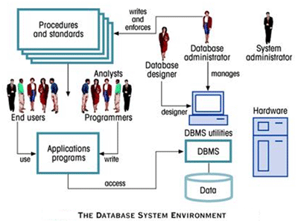
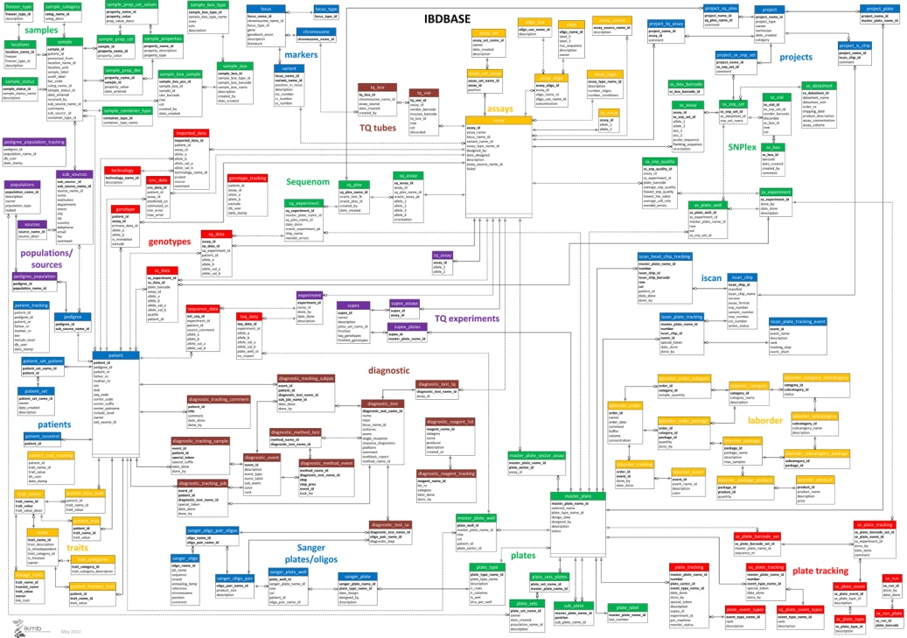

Database preservation intro
Most complex object to preserve?
Notes:
Talk about how a (current) database could potentially be one of the most complex objects to preserve: * That the data model itself might be really complicated
There are many technological components which make it a database;
That there is potentially a huge amount of data

Slide 5
Database preservation intro
In order to do database preservation:
Keep the data
Keep the structure
Keep the system
Keep it so that it all the above is understandable for generations to come ..
.. and even for people who do not have a DBA certificate
Manage it all within the budget..

Slide 6
Our possibilities to date
Emulation
Allows to preserve a lot of the complexity of a database, but
Need for specialised staff
Complex to keep alive and use
Cost of licences
Overall cost???
Migration to archival formats
How much of a database are we able to migrate?
Need for additional (manual) descriptions to keep the context
Tools needed to automate the process for both archiving and reuse
But managable with regular costs

Slide 7
State of the art
Emulation is not widely used due to the lack of resources
Migration seen as a viable option
Multiple open preservation formats available based on technologies like JSON, XML, CSV etc.
A number of tools (and counting) to support the migration into preservation formats and reuse
Notes:
(SIARD, DDI, multiple local or national specifications)

Slide 8
Today it’s about ..
SIARD is (one of) the most accepted format(s) for preserving relational databases
SIARD 2.0 published in 2015 in collaboration between the Swiss Federal Archives and the E-ARK project
Allowing to store most of the crucial elements of a relational database
Addressing scalability
Backwards compatibility with SIARD (1.0)

Slide 9
Today it’s about ..
The preservation tools
Database Preservation Toolkit
SIARD Suite
The access tools
Database Visualisation Toolkit
SIARDexcerpt
Notes:
Talk a bit about all the tools..

